Slide 1
E-Commerce Logistics and Statement Management System
DAMG6210 Data Mgt and Database Design Fall 2025
Team 1: Zehui Bao | Anqi Lin | Xinrui Shi
Ke Zhang | Xingguang Chen

Slide 2
Agenda
Project Overview & Objectives
ERD Design
SQL DDL Implementation Walkthrough
Analytical Reporting Views
OrderSummary
InventoryStatus
ProductSalesSummary
5. Visualization

Slide 3
Database Purpose
The database is designed to support the core operations of an e-commerce business by providing accurate, real-time data across multiple functions. It enables:
Inventory Management
Order Processing
Logistics & Shipment Tracking
Customer Billing & Payment Reconciliation
Business & Financial Reporting
By integrating these functions into a single source of truth, the database supports cross-department coordination—including operations, accounting, and customer service—and ensures timely fulfillment, accurate financials, and improved customer satisfaction.

Slide 4
Business Problems Addressed
Duplicate & Inconsistent Customer Data : Need to centralize and normalize customer and address records across sales, billing, and shipping systems.
Unclear Product Relationships : Require clear product–supplier mappings to support cost control, sourcing decisions, and inventory planning.
Inventory Stockouts & Overstocking : Must monitor inventory levels across multiple warehouses in real time to avoid lost sales or excess holding costs.
Limited Order Lifecycle Visibility : Need end-to-end tracking from purchase to delivery, with invoice creation separated from payment collection to track outstanding balances and customer credit.
Fragmented Financial Reporting : Must generate consolidated statements showing total revenue, cost, and profit margins for specific time periods.

Slide 5
Business Rules
Each product may be stocked in multiple warehouses.
Each warehouse can hold multiple products.
Each shipment has multiple orders. Each order has multiple shipments.
Each order is made by multiple customers and contains multiple products.
Each order has multiple payment. Each payment has multiple orders.
Each payment is associated with multiple invoices.
Each customer can have multiple addresses.
Each address may be reused by multiple customers (e.g., family accounts or shared work
addresses).
Financial reports are generated based on payment data.

Slide 6
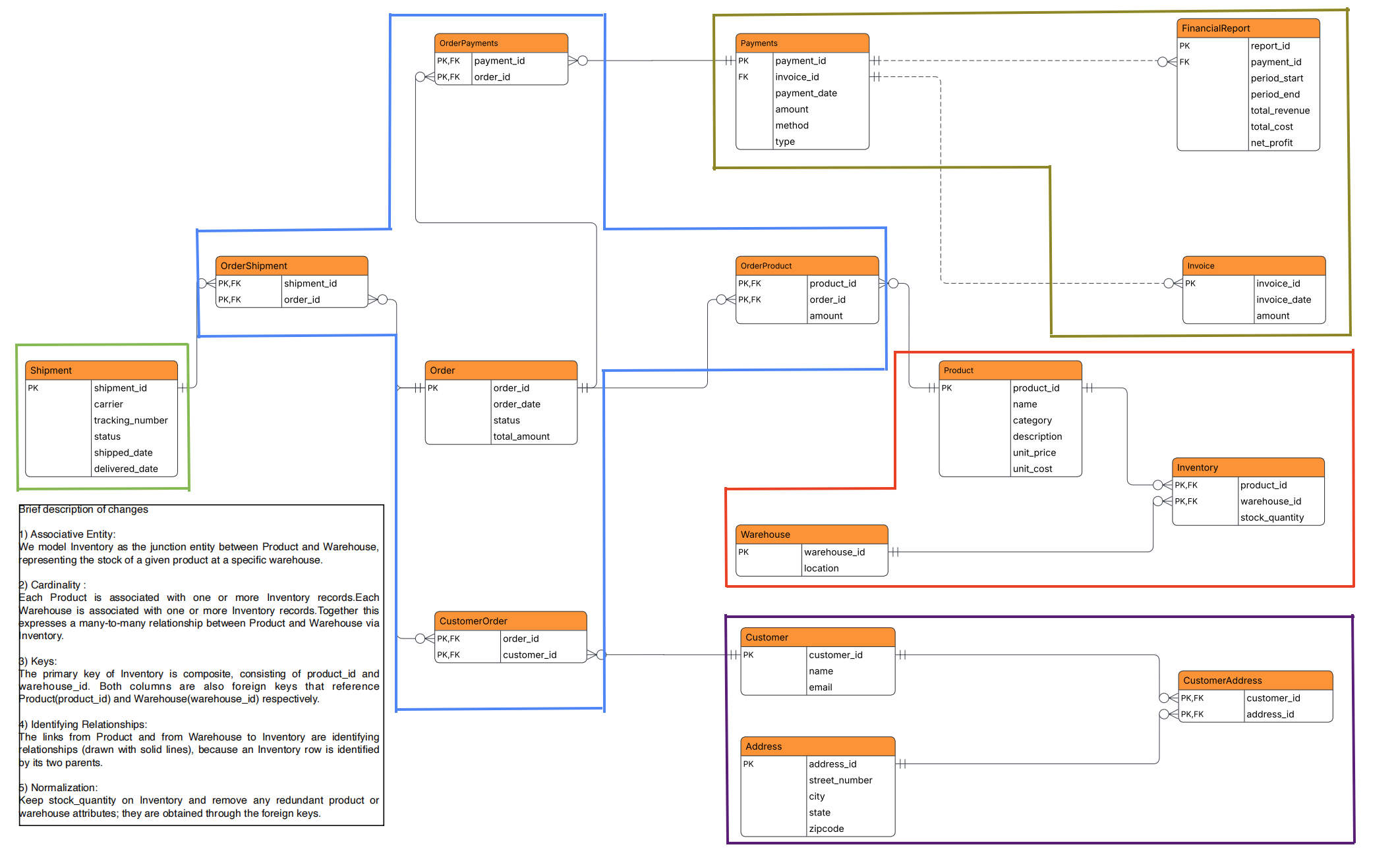

Final ERD Overview
Payments
Order
Shipping & Logistics
Product &
Inventory
Customers
Notes:
This ERD models the full lifecycle of an e-commerce business. Products are stored across multiple warehouses, and Inventory tracks stock levels. Customers can have multiple reusable addresses, supported by a CustomerAddress junction table. Orders represent purchases and are linked to products, shipments, customers, and payments through dedicated many-to-many junction tables. Billing is handled through Invoices and Payments, and aggregated payment data is fed into FinancialReports for monthly analysis. The design is fully normalized, avoids redundancy, and supports real-world e-commerce operations including split shipments, shared addresses, and multi-payment orders.

Slide 7

Key Entities : Order Processing
Order
Represents a customer purchase.
Attributes include order_date, status, total_amount.
Orders connect to:
customers (CustomerOrder)
products (OrderProduct)
shipments (OrderShipment)
payments (OrderPayments)

Slide 8

Key Entities : Product & Inventory
Product
Stores product details (name, category, cost, price).
A product can appear in multiple warehouses and multiple orders.
Warehouse
Represents physical storage locations.
Inventory
A linking entity between Product and Warehouse showing stock quantities.
Forms a composite primary key (product_id, warehouse_id).

Slide 9
Key Entities : Customer & Address Management
Customer
Stores customer profile (name, email).
A customer can place many orders and have multiple addresses.
Address
Stores reusable address data (street, city, state, zip).
Customers link to addresses through CustomerAddress.
CustomerAddress
Implements many-to-many relationship between Customer and Address.
Supports scenarios like:
multiple customers sharing one address
a customer having several addresses

Slide 10
Key Entities : Shipping & Logistics
Shipment
Tracks shipping events (carrier, tracking number, status, dates).
An order may be fulfilled by multiple shipments (e.g., split shipments).
A shipment may contain items from multiple orders (optional design).

Slide 11

Key Entities : Billing, Payments & Reporting
Invoice
Represents billing documents for orders.
Payment
Represents payments received (method, type, amount).
Payments are linked to orders and invoices.
FinancialReport
Aggregates financial metrics (revenue, cost, profit) from Payment.
It links to Payment via a foreign key.

Slide 12
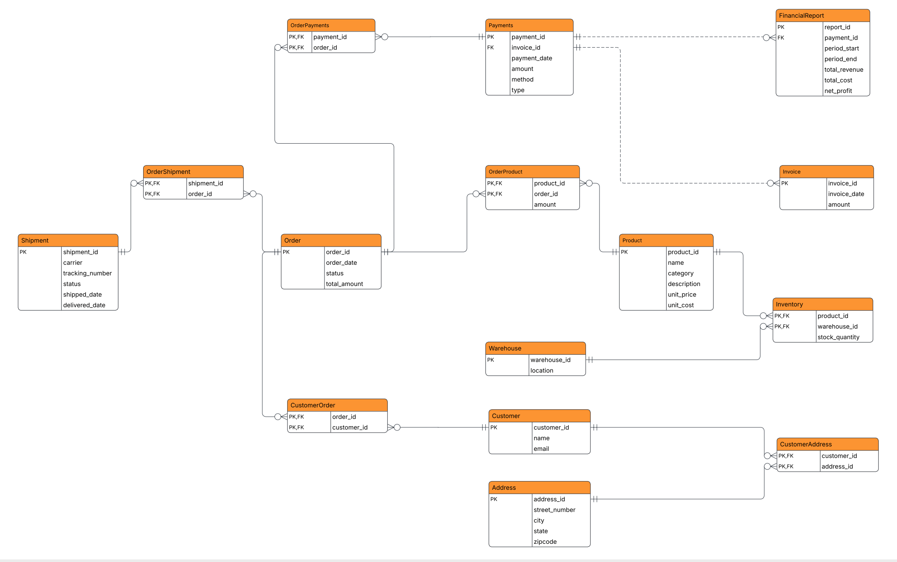
Final ERD Overview
Notes:
This ERD models the full lifecycle of an e-commerce business. Products are stored across multiple warehouses, and Inventory tracks stock levels. Customers can have multiple reusable addresses, supported by a CustomerAddress junction table. Orders represent purchases and are linked to products, shipments, customers, and payments through dedicated many-to-many junction tables. Billing is handled through Invoices and Payments, and aggregated payment data is fed into FinancialReports for monthly analysis. The design is fully normalized, avoids redundancy, and supports real-world e-commerce operations including split shipments, shared addresses, and multi-payment orders.

Slide 13
Database Implementation (SQL DDL)
Database name: SupplyChainDB_Group.
Core entity tables:
Customer, Address, Warehouse, Product, Order, Shipment, Invoice, Payments, FinancialReport.
Junction / relationship tables:
CustomerAddress, CustomerOrder, OrderProduct, Inventory, OrderShipment, OrderPayments.
Primary keys:
Identity PKs on main entities (e.g., customer_id, product_id, order_id, payment_id, report_id).
Composite PKs on junction tables (e.g., (product_id, warehouse_id) in Inventory).
Foreign keys enforce all major business rules (customer–address reuse, product–warehouse inventory, order–shipment, order–payment, payment–invoice, payment–financial report).

Slide 14
Advanced Data Integrity & Security
Function-based CHECK constraint on inventory
Created scalar function dbo.fn_CheckInventoryStock(@Quantity INT) returning 1 when 0 ≤ quantity ≤ 10000.
Table Inventory has constraint CK_Inventory_StockRange: CHECK (dbo.fn_CheckInventoryStock(stock_quantity) = 1).
Ensures stock quantities stay within a realistic and valid range.
Column-level encryption for customer email
Created database master key, certificate Cert_SupplyChain, and symmetric key SK_CustomerEmail (AES-256).
Added column email_encrypted VARBINARY(256) to Customer.
Encrypted existing email data into email_encrypted and provided sample query to decrypt values when needed.

Slide 15
Reporting Views for Analytics
Implemented three SQL Server views for reporting and monitoring:
vOrderSummary – one row per order with customer information.
vInventoryStatus – stock level by product and warehouse.
vProductSalesSummary – total quantity and revenue per product.
Views are built on top of the base tables and use joins and aggregation to answer typical business questions:
What has each customer ordered and how much did they spend?
How much stock do we have for each product in each warehouse?
Which products are best-selling in terms of units and revenue?

Slide 16
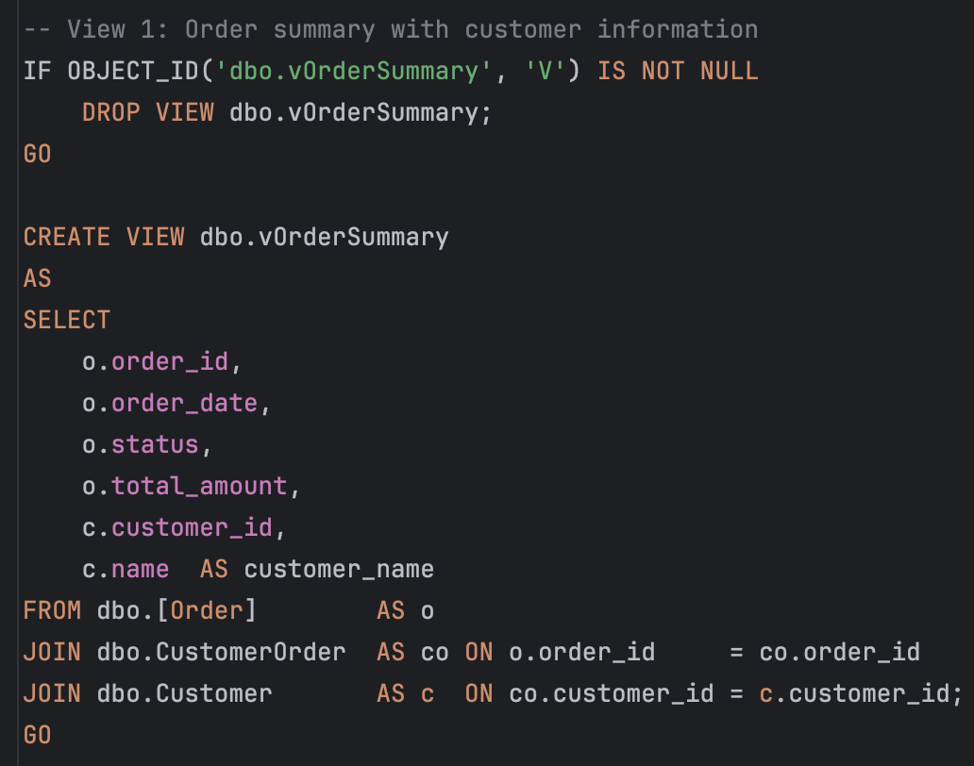
View 1 – vOrderSummary
Bullets：
Purpose: summarize order header + customer information.
Columns: order_id, order_date, status, total_amount, customer_id, customer_name.
Joins: [Order] → CustomerOrder → Customer.

Slide 17
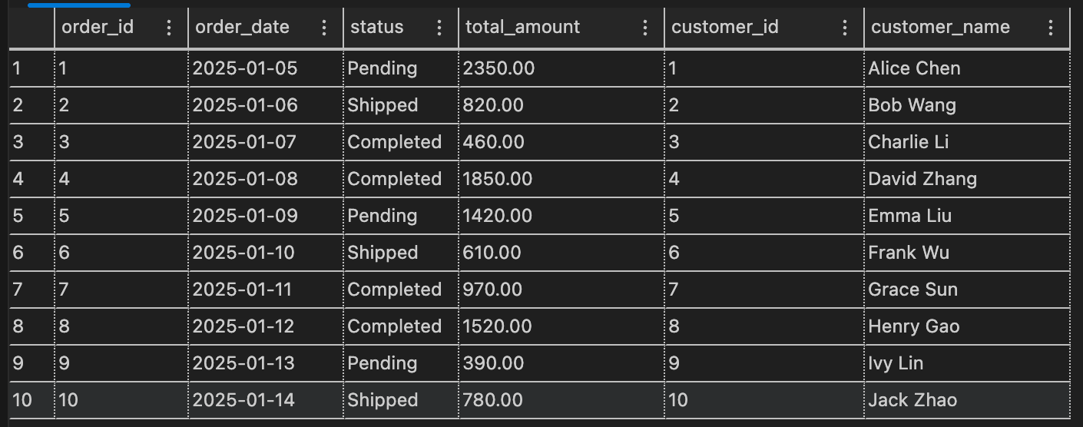
View 1 – vOrderSummary
Bullets：
Purpose: summarize order header + customer information.
Columns: order_id, order_date, status, total_amount, customer_id, customer_name.
Joins: [Order] → CustomerOrder → Customer.

Slide 18
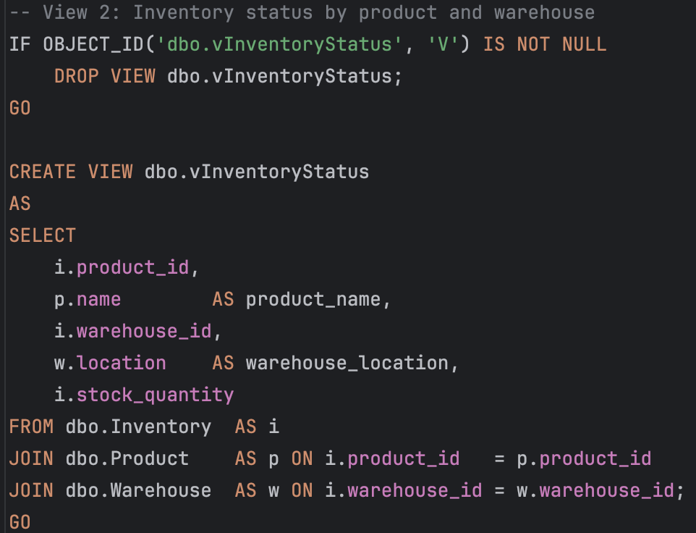
View 2 – vInventoryStatus
Bullets：
Purpose: show current inventory level by product and warehouse.
Columns: product_id, product_name, warehouse_id, warehouse_location, stock_quantity.
Joins: Inventory → Product → Warehouse.

Slide 19
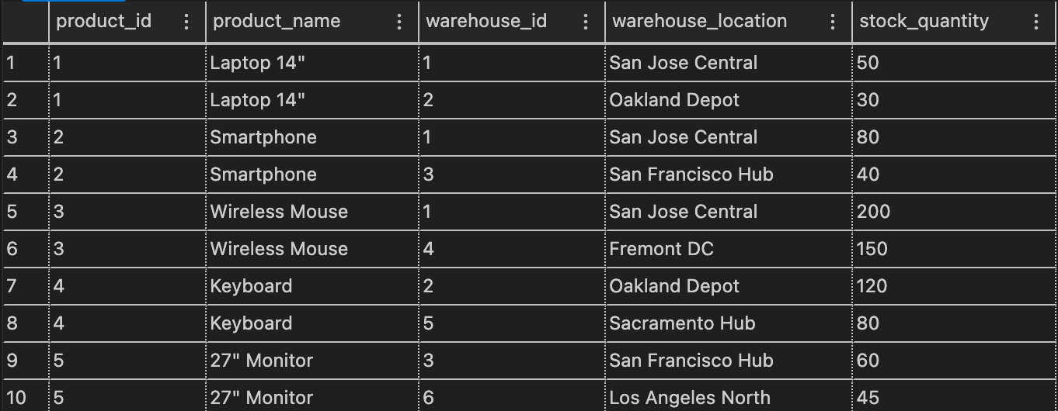
View 2 – vInventoryStatus
Bullets：
Purpose: show current inventory level by product and warehouse.
Columns: product_id, product_name, warehouse_id, warehouse_location, stock_quantity.
Joins: Inventory → Product → Warehouse.

Slide 20
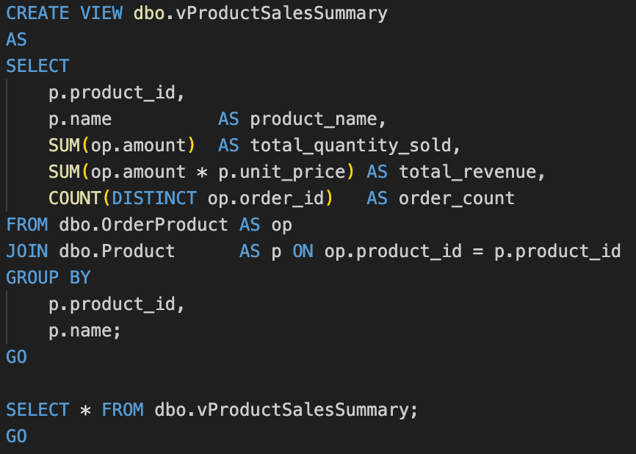
View 3 – vProductSalesSummary
Bullets：
Purpose: show product-level sales performance, including total quantity sold, revenue, and number of orders per product.
Columns: product_id, product_name, total_quantity_sold, total_revenue, order_count.
Joins: OrderProduct → Product.

Slide 21
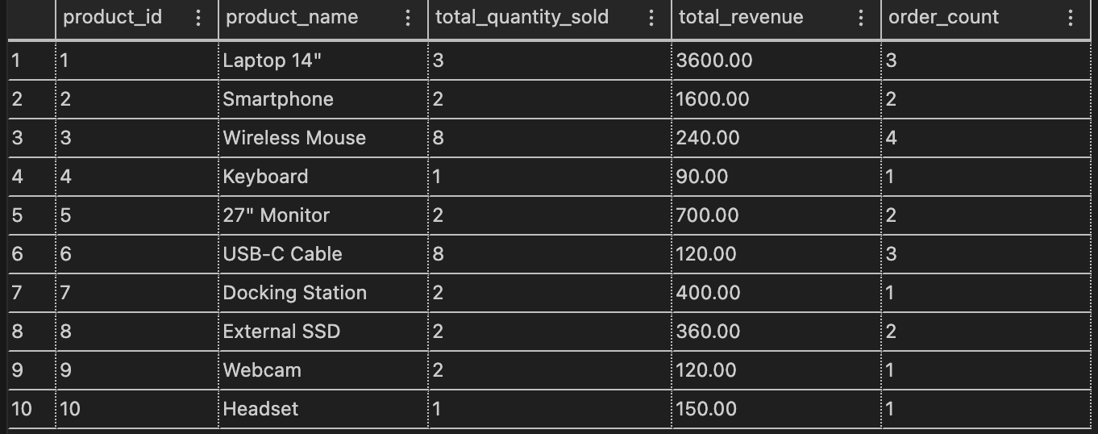
View 3 – vProductSalesSummary
Bullets：
Purpose: show product-level sales performance, including total quantity sold, revenue, and number of orders per product.
Columns: product_id, product_name, total_quantity_sold, total_revenue, order_count.
Joins: OrderProduct → Product.

Slide 22
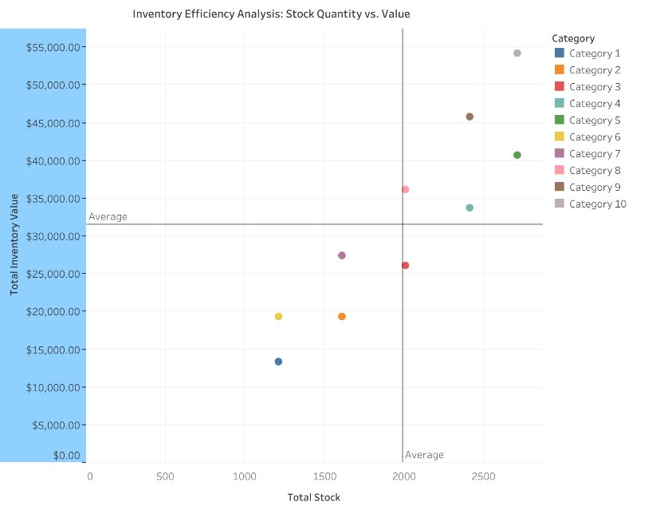
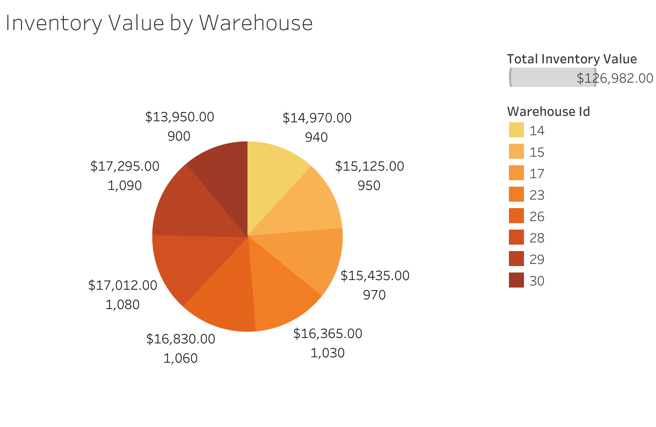
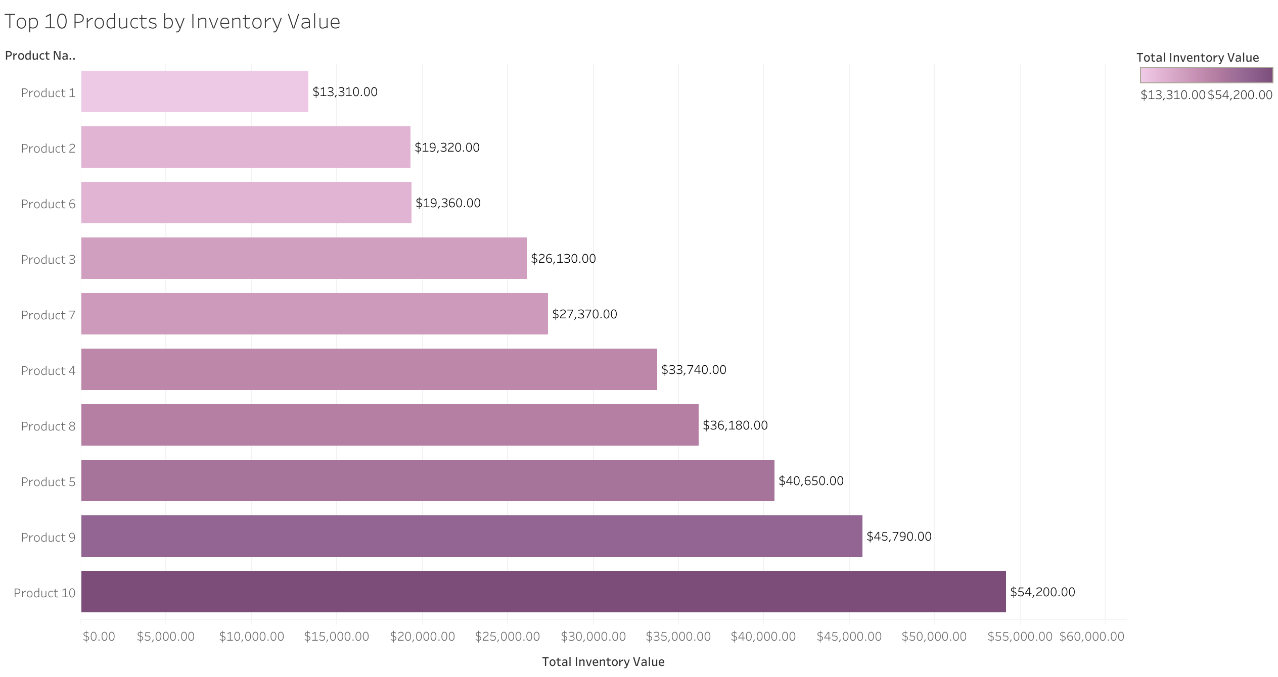
Visualizations_Tableau
WHERE: Warehouse Distribution
• Balanced allocation across locations
• Minimizes concentration risk
HOW: Efficiency Analysis
• Four-quadrant framework
• Identifies optimization opportunities
WHAT: Product Value Ranking
• High value concentration in top products
• Enables focused management
Key Insight: Multi-dimensional analysis supports data-driven inventory decisions

Slide 23
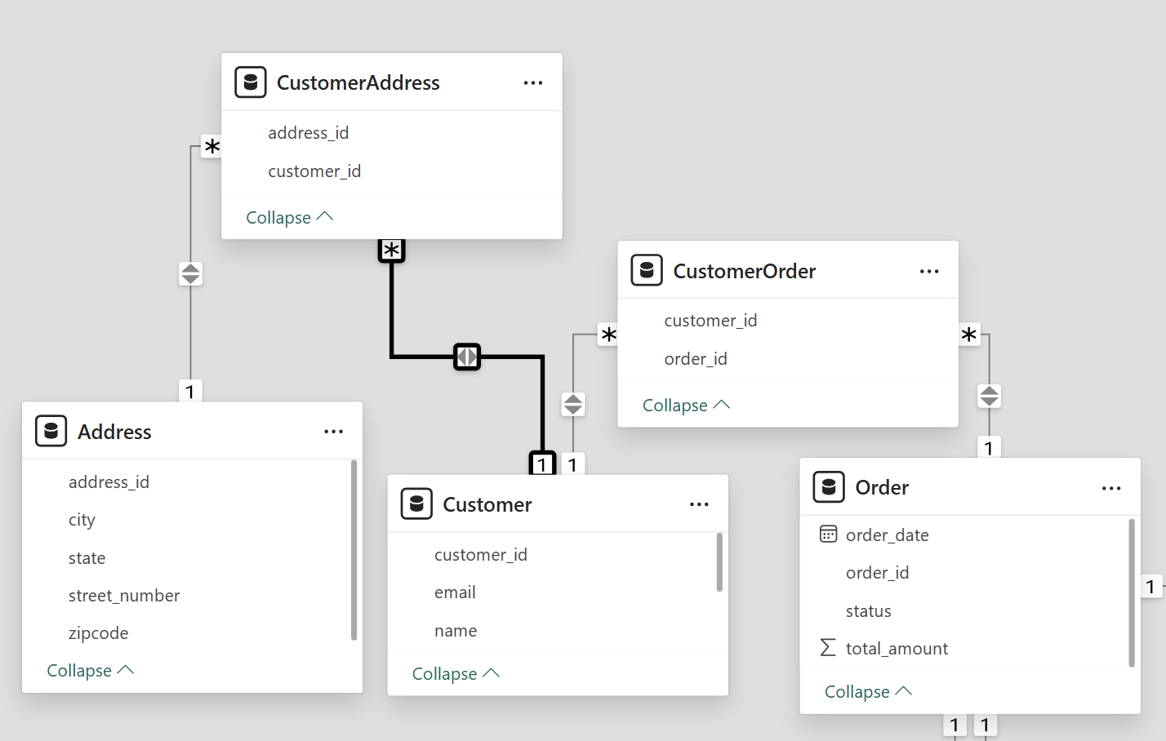
Visualizations_Power BI
OntimeRate in dfferent Carriers
Delivery_status:Created/Delivered/Transit
Occupation by total_amount by city
Customer Count by City

Slide 24
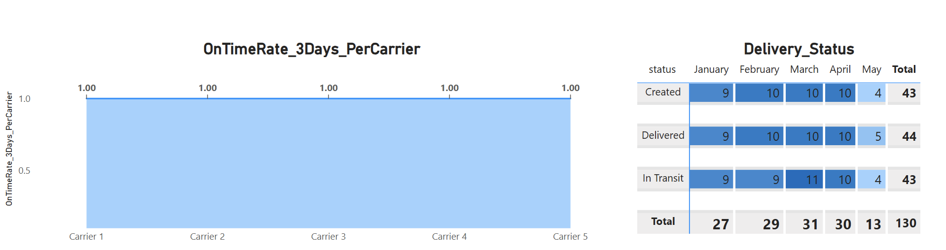
Visualizations_Power BI
X-axis – carrier
Y-axis -- OnTimeRate_3Days_PerCarrier
OnTimeShipments_3Days_PerCarrier =
CALCULATE (
COUNTROWS ( Shipment ),
Shipment[TransportDays] <= 3
)
TotalShipments_PerCarrier =
COUNTROWS ( Shipment )
OnTimeRate_3Days_PerCarrier =
DIVIDE (
[OnTimeShipments_3Days_PerCarrier],
[TotalShipments_PerCarrier]
)

Slide 25
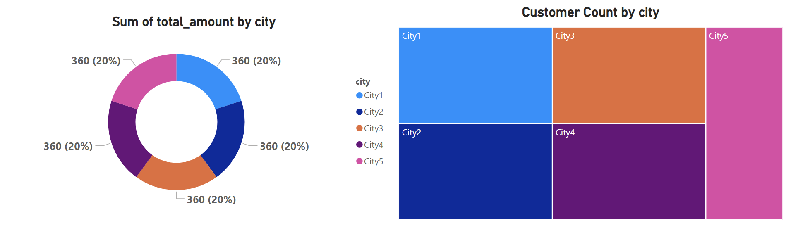
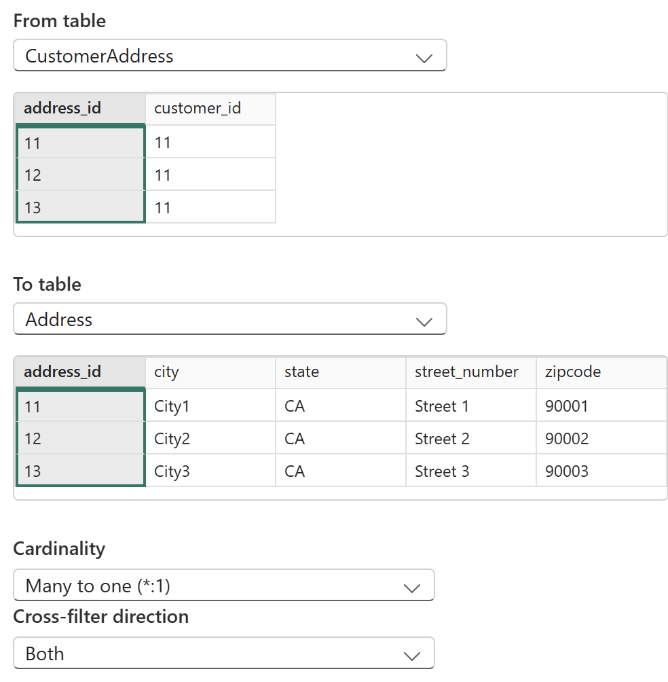
Visualizations_Power BI
Customer Count =
DISTINCTCOUNT ( Customer[customer_id] )

Slide 26
Q & A
Thank you

